Slide 1



Unit 5: Week 3
Grade K

Slide 2
Copyright © Savvas Learning Company LLC. All Rights Reserved.
This publication is protected by copyright, and permission should be obtained from the publisher prior to any prohibited reproduction, storage in a retrieval system, or transmission in any form or by any means, electronic, mechanical, photocopying, recording, or otherwise. For information regarding permissions, request forms, and the appropriate contacts within the Savvas Learning Company Rights Management group, please send your query to:
Savvas Learning Company LLC, 15 East Midland Avenue, Paramus, NJ 07652
or
k12learningpermissions@savvas.com
myView Literacy® is an exclusive trademark of Savvas Learning Company LLC in the U.S. and/or other countries.

Slide 3

Lesson 1

Slide 4
Phonological Awareness
alligator
spider
cowgirl
volcano
Notes:
Tell students that today they are going to take apart and put together syllables. Let’s say the word back together. Clap for each syllable: back (clap). How many syllables are in back? Students should say one. Now let’s say the word pack together. Clap for each syllable: pack (clap). How many syllables are in pack? (one) What new word do we make if we put the syllables back and pack together? Students should say backpack.
Now listen as I say the word dinosaur. I will clap for each syllable: di (clap) no (clap) saur (clap). How many syllables did I say? (three) Let’s put the syllables together and say the word: dinosaur. What word did you hear? Students should say dinosaur. Continue the activity with alligator, spider, cowgirl, and volcano.
Display the apple, elbow, feather, and umbrella Picture Cards. Guide students as they segment and blend the syllables in each word.

Slide 5
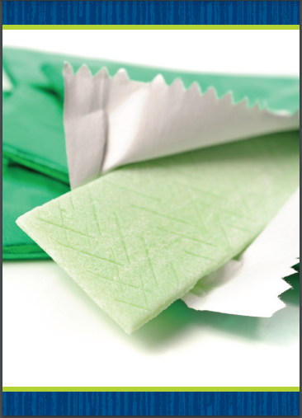

Page 88
Phonics
gape
gal
gift
quit
quake
quite
Notes:
Hold up the gum Picture Card. What sound do you hear at the beginning of gum? (/g/) Turn the card over and point out the first letter in gum. Tell students that the sound /g/ is spelled with the letter g. Then read the word gum with students. Now let’s practice reading more words with the sound /g/ spelled g. Write the words gape, gal, and gift on the board. These words begin with the sound /g/. Circle the g in each word. Have students read the list. Repeat the activity for Qq with the quilt Picture Card and these words: quit, quake, quite. Click path -> Table of Contents -> Unit 5 Week 3 Poetry -> Lesson 1
Have students turn to p. 88 in the Student Interactive. Read the words in the bank with students. Now we will use these words to complete sentences. Which word from the bank tells about the first picture? Let’s write quiz to finish the sentence. Have students read the sentence.

Slide 6
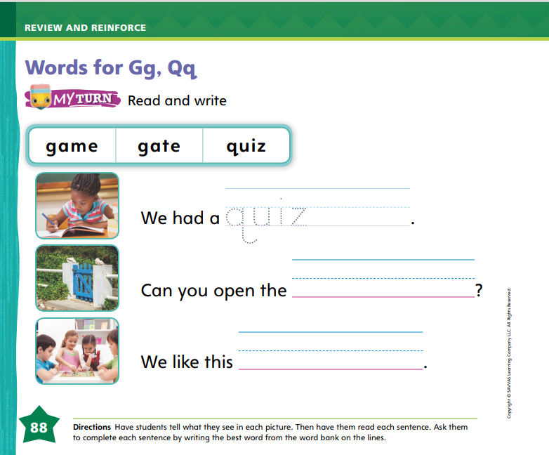
Page 88
Phonics
Turn to page 88 in your Student Interactive and complete the activity.
Notes:
Have students finish p. 88 in the Student Interactive.

Slide 7
High-Frequency Words
who
there
into
Notes:
Display the high-frequency words who, there, and into, and read them aloud.
Have students point to the word who and read it.
Repeat for there and into.

Slide 8
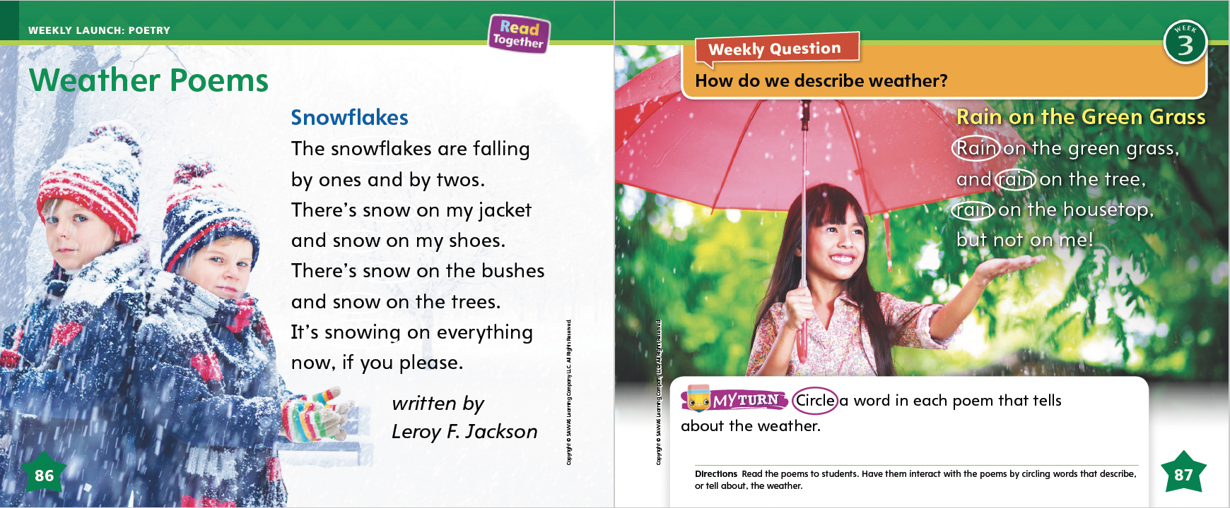
Page 86, 87
Interact with Sources
Circle a word in each poem that tells about the weather.
Notes:
Remind students of the Essential Question for Unit 3: What can we learn from the weather? Point out the Weekly Question: How do we describe weather? Tell students that they will read more about the weather this week. Turn to pp. 86–87 in the Student Interactive. Use the following prompts to discuss the poems on these pages:
Tell students that a poem is a text that has rhythm and sometimes rhyme. Explain that the poems on pp. 86–87 are about the weather.
Ask what kind of weather they think the poem on p. 86 is about. Then read aloud the poem while students listen. Then reread the poem, this time asking students to join in when they can. You may want to pause before the second rhyming word to allow students to say it.
Repeat with the poem on p. 87.
Encourage students to ask questions about the poems to clarify any information or ideas they do not understand.
Have students interact with sources by circling words that describe snow and rain. Have them describe personal experiences in one or both types of weather.
Remind students of the Week 3 Question: How do we describe weather? Tell students that we can read about weather in informational texts, stories, and poems, and we can talk about it with each other.

Slide 9
Listening Comprehension
Life in the Rainforest
Poem | Rhyming words or words with similar sounds
Winter Fun
The Storm
Notes:
Tell students that they will listen to you read two poems. Remind them that poems can tell a story, but they use rhythm and sometimes rhyme to tell it. Have students listen as you read aloud the poems “Winter Fun” and “The Storm.” Tell students to be active listeners by looking at you and thinking about what you are saying as you read aloud.
Have students listen actively for elements of poetry, such as rhyming words and rhythm.
Read the entire text aloud without stopping for the Think Aloud callouts.
Reread the text aloud, pausing to model Think Aloud strategies related to the genre.
Tell students that poems often contain rhyming words. They may also contain other words with similar sounds. Have students listen again to the words that begin each line of "The Storm." Guide them to recognize that each of these words ends with -ing.

Slide 10
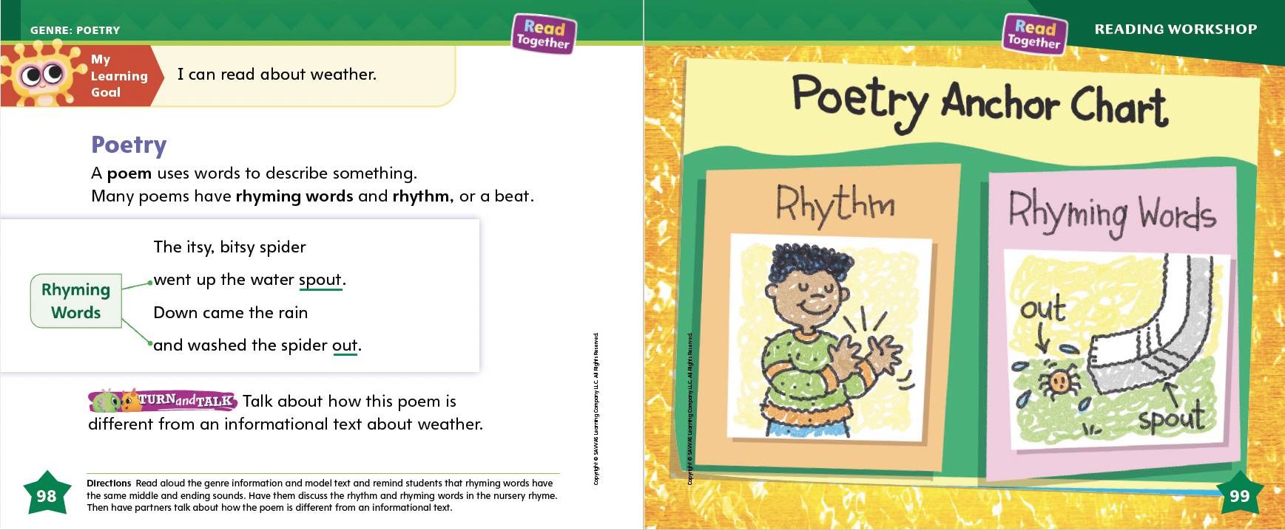
Page 98, 99
Poetry Qualities
Turn to page
98 in your Student Interactive.
Notes:
Tell students that poems and nursery rhymes are texts made up of words arranged in lines. Tell students that nursery rhymes are a type of traditional poetry or song. Explain that you are going to discuss some of the elements of poetry and nursery rhymes.
Poems and nursery rhymes have a rhythm or beat. Tap out a beat with students and have them repeat it.
Poems and nursery rhymes often have rhyming words. Rhyming words have the same ending vowel and consonant sounds.
Read aloud the poem on p. 98. I can hear a rhythm in this poem. I can tap the rhythm as I read. Read through the poem again. Have students tap the beat or rhythm with you.
I also heard a rhyme. Did you hear the words that rhyme? Read through the poem again, emphasizing the words spout and out at the end of the lines. Have students clap when they hear the rhyming words. Point out that the poem also uses other rhyming words within the line: itsy, bitsy.
Read the text and review the Anchor Chart on pp. 98-99 of the Student Interactive. Editable Anchor Chart Click Path: Table of Contents -> Reading Anchor Charts -> Unit 5 Week 3: Poetry Editable Reading Anchor Chart

Slide 11
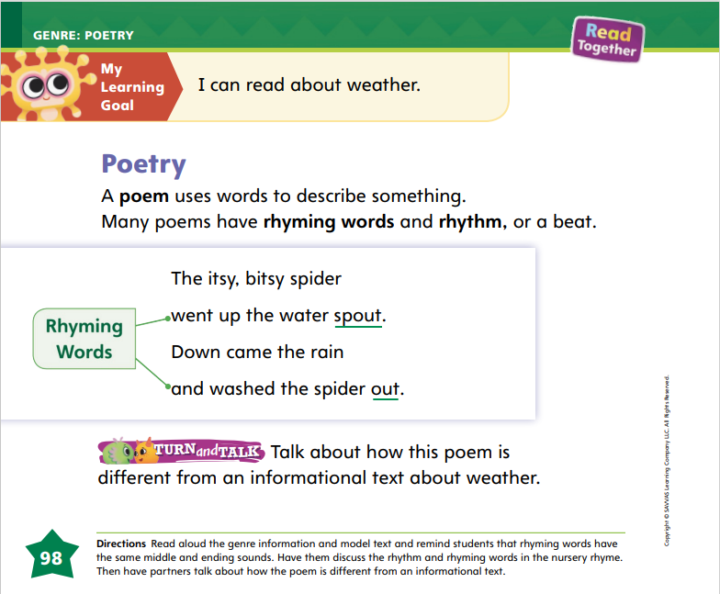

Page 98
Apply
Talk about how the poem is different from an informational text about weather.
Notes:
Have students use the strategies for identifying poetry.
Have students turn and talk with a partner about the differences between a poem and informational text.
Then have partners share their ideas with the class.

Slide 12
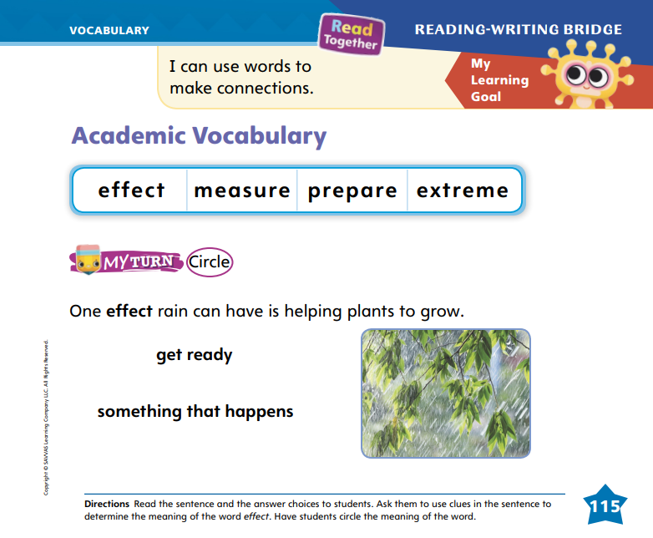
Page 115
Academic Vocabulary
The tree fell down because the wind so extreme.
Turn to page
115 in your Student Interactive.
Notes:
Tell students that they can use clues from pictures or other words in the sentences to help them understand the meaning of a word they do not know.
What do you see in the pictures that can help you figure out the meaning of the words?
What other words are near the word you do not know? How can these words help you understand the word you do not know?
Write the following sentence: The tree fell down because the wind was so extreme. The word extreme is one of our Academic Vocabulary words. What can I do if I don’t know what extreme means? Let’s read the sentence again. It says a tree fell over in the wind. It would take a really strong wind to knock down a tree! Extreme must mean very strong or very great. “Tree fell down” and “wind” are clues that helped me figure out what extreme means.
Ask students to use the context to circle the correct meaning of the word effect on p. 115 of the Student Interactive.

Slide 13
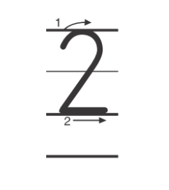
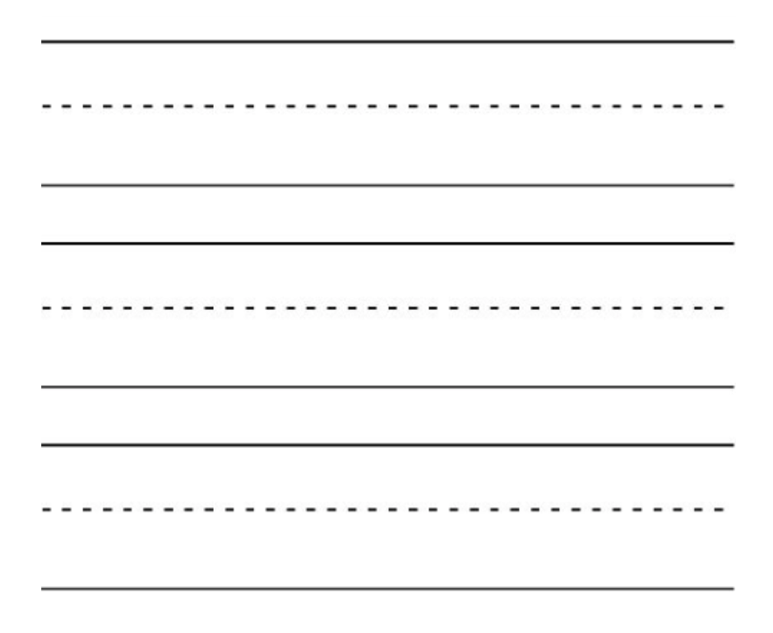
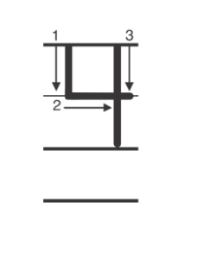
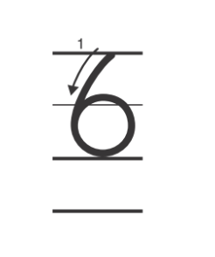
Handwriting
Notes:
Display the numerals 2, 4, and 6. Ask students to name the numbers.
Model writing the numerals 2, 4, and 6, pointing out how each number starts, what to do next, and how to finish it. Then ask students to form the numerals in the air with their fingers.
Have students use Handwriting p. 272 in the Resource Download Center to practice writing numerals 2 and 4 and to review writing numerals 1, 3, and 5. Click path: Realize -> Table of Contents -> Resource Download Center -> Handwriting Practice -> U5W3L1 Handwriting Practice

Slide 14
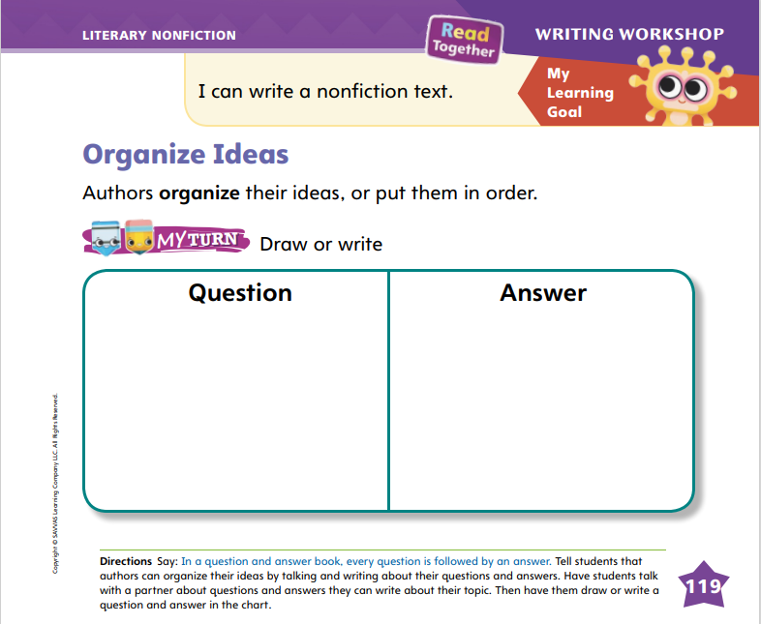
Page 119
Writing – Literary Nonfiction
Turn to page 119 in your Student Interactive.
Notes:
Authors organize question and answer books by putting their questions and answers in order. The most important questions and answers come first in a question and answer book.
Read a book from the stack, and point out the questions and answers. Remind students that in a question and answer book, the questions come first and the answers come after each question. Say: Authors organize their questions and answers. They put the most important questions and answers first.
Continue reading texts from the stack. Ask students what the most important question might be about the topic for each book. Then read the first question and answer aloud. Ask students why the author might have chosen to put this question and answer first. Using a book that begins with a very broad question and answer, say: The first question and answer help introduce the topic. They are more general than the others because they are designed to get readers interested in the topic.
Direct students to complete p. 119 in the Student Interactive. Remind students that authors write a question followed by an answer. In the spaces provided, students should draft a question and answer for their own books.

Slide 15

Independent Writing
Think about the most important question and answer for your topic. Review the order of your questions.
Share how you decided the order of your questions and answers.
Notes:
After learning about the way authors organize questions and answers in a book, have students think about the most important question and answer for their topic.
Have them review the order of the questions in their book before continuing to write. Remind them that they can start over or begin a new book at any time.
Writing Support
Modeled - Use stack texts to demonstrate how authors organize ideas, pointing out which question and answer come first.
Shared - Work with students to help them organize their books. Help them determine which question and answer are the most important.
Guided - Use a stack text to provide explicit instruction for organizing ideas and choosing the order of questions and answers.
Ask a few students to share how they decided the order of their questions and answers.

Slide 16
Spelling
Jenna is at school.
I am walking the dog.
Can I have an apple?
He is busy as a bee.
Who is that girl?
We can go into the store.
Notes:
(Note: Move the orange boxes to cover each bold spelling word before you read aloud the words and sentences.)
Read aloud the words and sentences. Have students spell each word with initial consonant blends and the two high-frequency words.
Jenna is at school.
I am walking the dog.
Can I have an apple?
He is busy as a bee.
Who is that girl?
We can go into the store.
Reveal the spelling word and have students check their work.

Slide 17
Language and Conventions
Can it fly
It can fly
It’s really flying
With your partner, take turns saying sentences that end with different types of punction.
Notes:
Remind students that sentences end with punctuation.
Write different types of sentences and model adding punctuation: Can it fly; It can fly; It’s really flying. This first sentence is a question. It starts with a question word: can. I need to add a question mark. The next sentence is a statement that tells me something can fly. I need to add a period. The next sentence is said with some excitement so I will add an exclamation point.
Pair students and have them take turns saying sentences that end with different types of punctuation.

Slide 18
Lesson 2

Slide 19
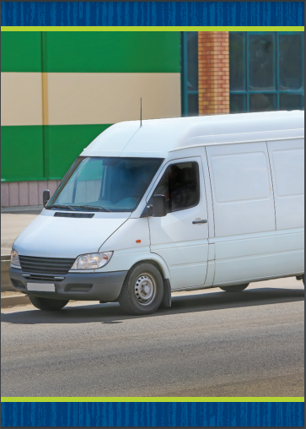

Page 89
Phonics
take
tape
Notes:
Hold up the van Picture Card. This is a picture of a van. Listen to the sounds in the word: /v/ /a/ /n/. I hear the sound /a/ in the middle of van. Say the sound /a/ with me. Turn the card over so students can see the spelling. What letter spells the sound /a/ in van? Students should say a.
Hold up the lake Picture Card. This is a picture of a lake. Listen to the sounds in the word: /l/ /ā/ /k/. I hear the sound /ā/ in the middle of lake. Say the sound /ā/ with me. Turn the card over so students can see the spelling. What vowel pattern spells the sound /ā/ in lake? Students should say a_e. Click path -> Table of Contents -> Unit 5 Week 3 Poetry -> Lesson 2
Write the word take on the board. Let’s read this word together. What is the sound for t? What is the sound for the pattern a_e? What is the sound for k? Let’s blend the sounds together: /t/ /ā/ /k/, take. Erase the k and write the letter p. I have changed a letter to make a new word. Let’s read the new word together: /t/ /ā/ /p/, tape.
Delete the letter t and continue the routine to read the new word. (ape) Repeat with the following word chain, identifying the letter that was added or changed and reading the new words: am, ham, ram.

Slide 20
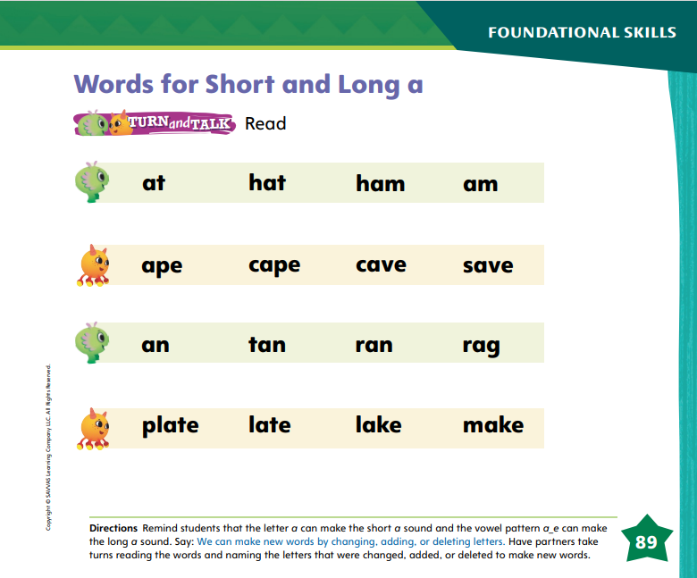
Page 89
Apply
Turn to page 89 in your Student Interactive and complete the activity.
Notes:
Have students complete p. 89 in the Student Interactive.

Slide 21
High-Frequency Words
who
there
into
Notes:
Tell students that high frequency words are words that they will hear and see over and over in texts.
Write and read the words who, there, and into.
Have students
repeat the words after you.
spell each word, clapping as they say each letter.

Slide 22
Page 100
Preview Vocabulary
roots
mound
squash
shoots
Notes:
Read the words mound, squash, shoots, and roots on p. 100 of the Student Interactive. As you read each word, have students point to the word and say it with you.
Prompt students to share what they know about these words. Ask questions, such as Where would you find the roots of a plant? What can you do with a squash?
Suggest that students look for these words as you read.

Slide 23
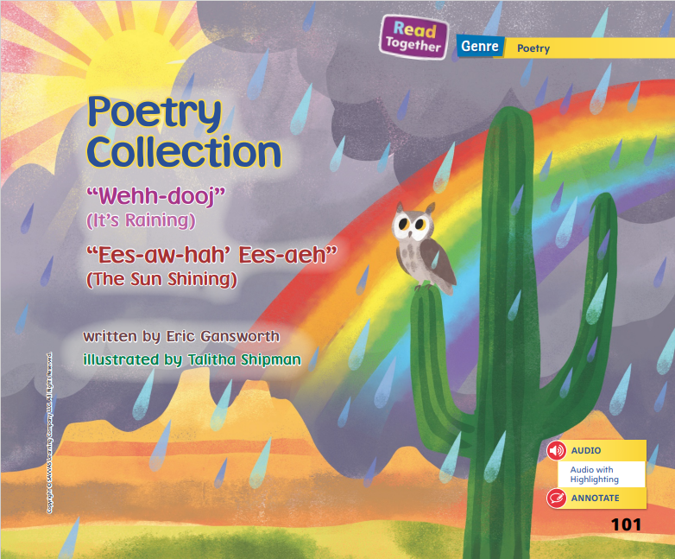
Page 101
First Read Strategies
Notes:
Read aloud the purpose for reading on p. 100 of the Student Interactive. Read the poems to discover new ways to describe weather. Tell students that having a purpose, or reason, for reading helps them take their time as they read so they will not skip important parts of the text. Discuss the First Read Strategies. In this first read, tell students to read for understanding and enjoyment. After students complete the First Read, ask: What did you like about the poems? Did you hear a rhythm?
First Read Strategies
READ Read or listen to the text. During the first reading, work to understand what the text is about.
LOOK Look at the pictures to help understand the text.
ASK Generate, or ask, questions about the text to deepen understanding.
TALK Talk to a partner about the text.
Help students read the whole text independently, in pairs, or as a whole class. Use the First Read notes to help students connect with the text and to monitor comprehension.

Slide 24
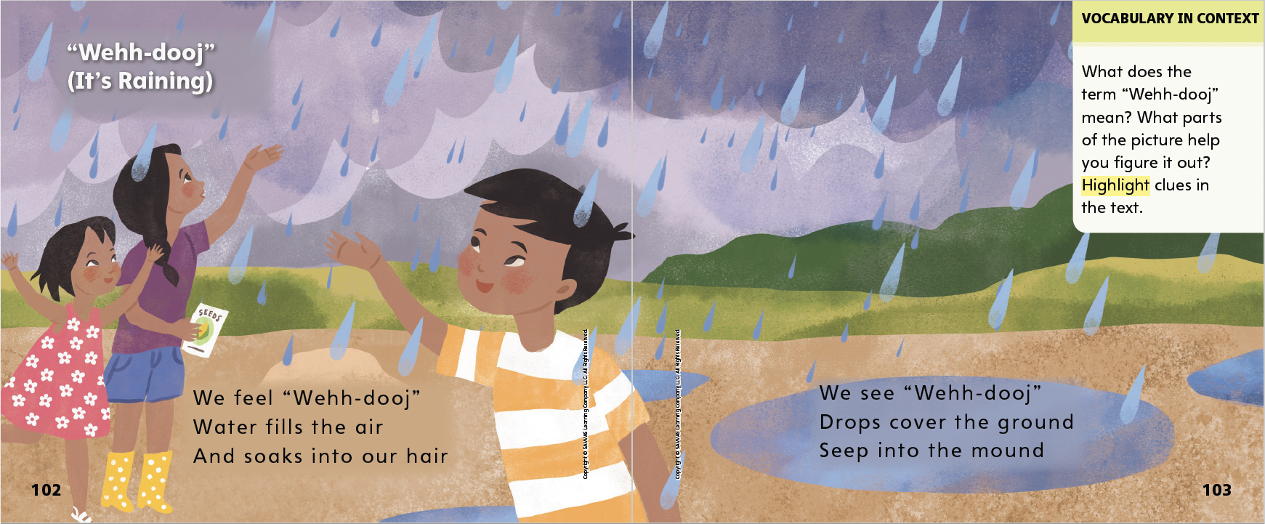

Page 102, 103
First Read – Poetry Collection
Notes:
Read Together.
THINK ALOUD I see that the title of this poem is “Wehh-dooj.” This is a Tuscarora term that means “it’s raining.” As I read, I am going to look for how the writer describes what happens as the children experience the rain.

Slide 25
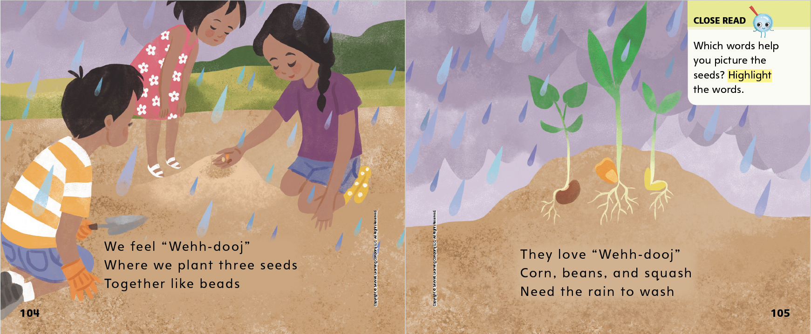
Page 104, 105
First Read – Poetry Collection
Notes:
Read Together.

Slide 26
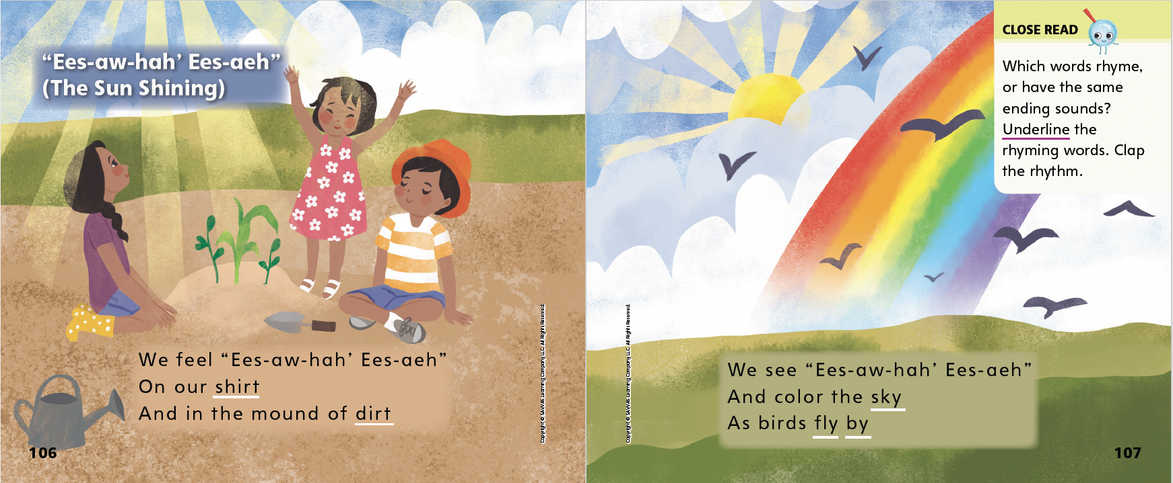
Page 106, 107
First Read – Poetry Collection
Notes:
Read Together.
THINK ALOUD I will look at the pictures to better understand what I’m reading. I see that the seeds have grown into plants. I see corn and squash blossoms. The sun is helping the plants grow. The rainbow shows that it has just rained.
I see that the title of this poem has words I don’t know, but below the title it tells me what the words mean. This is how you say the words: Ees-aw-hah’ Ees-aeh is pronounced ees-ah-ha ees-eh.

Slide 27
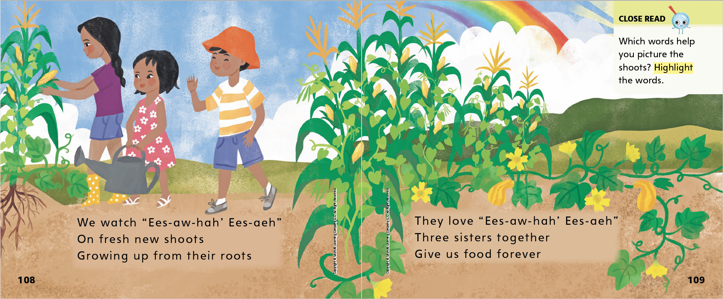
Page 108, 109
First Read – Poetry Collection
Notes:
Read Together.

Slide 28
Respond and Analyze
Brainstorm: How did the poems tell about the weather?
Discuss: Talk with a partner about what you like most about the poems and why.
Notes:
Use these suggestions to prompt students’ initial responses to reading “Wehh-dooj” and “Ees-aw-hah’ Ees-aeh.”
Brainstorm How did the poems tell about the weather?
Discuss Talk with a partner about what you liked most about the poems and why

Slide 29
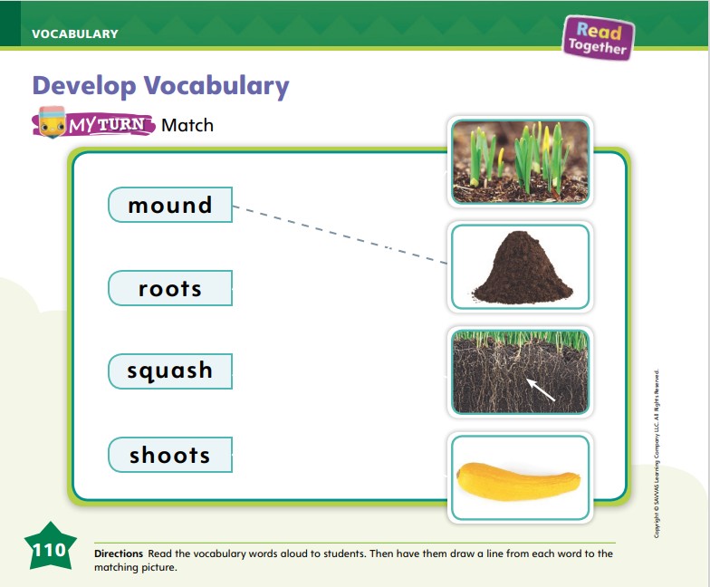
Page 110
Develop Vocabulary
Turn to page 110 in your Student Interactive and complete the activity.
Notes:
Tell students that the author of the poems used specific words to tell about plants and nature.
READ Read the word.
THINK Think about the meaning of the word. Use the pictures and text around the word to help you understand the word’s meaning.
DISCUSS Ask yourself questions such as: What pictures can a reader use to figure out the meaning of the word? Are there other nearby words that can help readers better understand this word?
Model how to complete the activity on p. 110 of the Student Interactive, using the word mound. Read aloud the word mound and then ask students to look at each picture on the page. I will look closely at each picture to find the one that is a mound. I know that a mound is a small hill or pile of earth, so that is what I’m looking for. I see it is the second picture. I will draw a line from the word to the picture.
Read aloud each of the words. Have students complete the matching activity on p. 110 in the Student Interactive. Tell students that familiar words can have more than one meaning. Have students identify a new meaning for the verb squash.

Slide 30
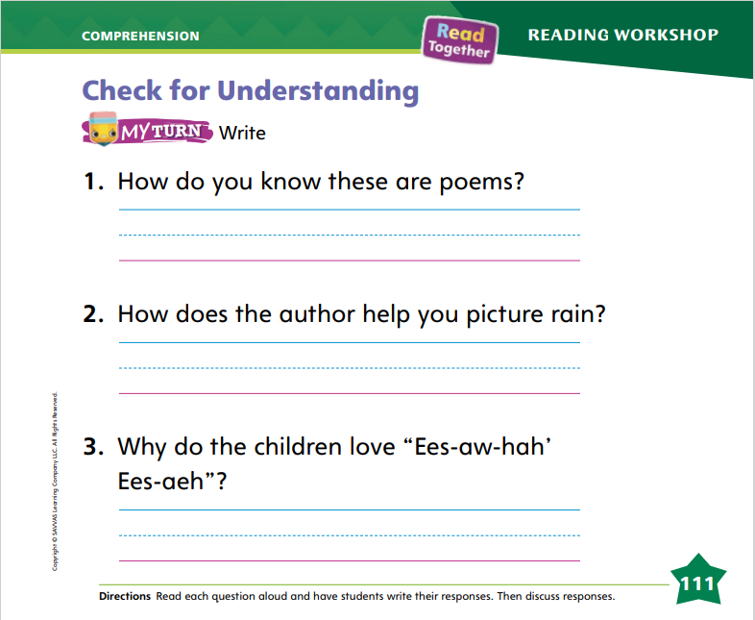
Page 111
Check for Understanding
Turn to page 111 in your Student Interactive and complete the activity.
Notes:
Have students complete the Check for Understanding on p. 111 of the Student Interactive.

Slide 31
Writing – Literary Nonfiction
Let’s look at how authors use introductions and conclusions in question-and-answer books.
Identify the introduction and conclusion in some other text.
Notes:
Question and answer books include an introduction that states the topic. They also include a conclusion. The conclusion is found at the end of the book and reminds readers about the topic.
Use stack texts to show students how authors use introductions and conclusions in question and answer books. Explain that an introduction tells the reader what the book is about. Read the introduction of a stack book aloud, and ask students what they think they will learn from the book. Continue to read the entire book, pausing before you get to the conclusion. Then explain that a conclusion comes at the end of the book and reminds readers about the main points of the book. Read the conclusion and ask students what the main points of the book were.
Use another stack text and have students identify the introduction and conclusion. Engage students in a discussion about why introductions and conclusions are important in question and answer books.

Slide 32
Independent Writing
Write your introduction and conclusion.
Draw a picture for your introduction or conclusion.
Share your idea for the introduction and conclusion with the class.
Notes:
Students should begin writing their introduction and conclusion if they have not done so already. Remind them to draw a picture to accompany their introduction or conclusion.
Writing Support
Modeled - Model writing an introduction and conclusion for your book.
Shared - Work with students to review words to include in introductions and conclusions.
Guided - Ask students why an introduction and conclusion are important.
If students demonstrate understanding, they can continue working on their books.
Call on several students to share their ideas for their introduction and conclusion with the class. Remind students to be active listeners.

Slide 33
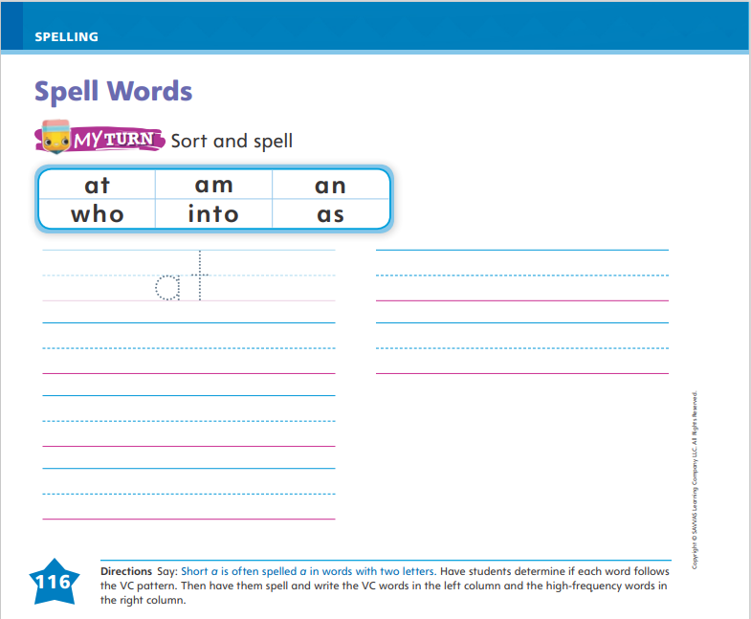
Page 116
Spelling
Turn to page 116 in your Student Interactive and complete the activity.
at
Notes:
Explain that words that have two letters, a vowel followed by a consonant, are VC words. The vowel sound in VC words is usually short.
Write or display the following VC word: at. Say the word aloud and point out that the word is spelled with the vowel a and the consonant t.
Have students complete the activity on p. 116 in the Student Interactive.

Slide 34
Language and Conventions
Jen.
She stands.
We.
How can you make an incomplete sentence complete?
Notes:
Explain that sentences need to express a complete thought. They need a naming part and an action part.
Say the following sentence: Jen. Then say: This sentence has a naming part. The naming part is Jen. Jen is who the sentence is about. But it is not a complete sentence. It does not have an action part. We don’t know what Jen does. Say the following word to complete the sentence: walks.
Say the following: She stands. We. Work with students to decide which sentence is a complete sentence and which is not. Ask students how you can make the incomplete sentence a complete sentence.

Slide 35
Lesson 3

Slide 36
Phonological Awareness
holiday
butterfly
watermelon
Notes:
Say the word holiday. Listen carefully as I count the syllables: hol (clap) i (clap) day (clap). How many times did I clap? Students should say three. How many syllables are in holiday? Students should say three. If I take away the last two syllables in the word holiday, what syllable is left? Students should say hol. If I take away the first two syllables in the word holiday, what syllable is left? Students should say day. If I take away the first and last syllables in holiday, what syllable is left? Students should say i.
Repeat the routine with the words butterfly and watermelon.

Slide 37
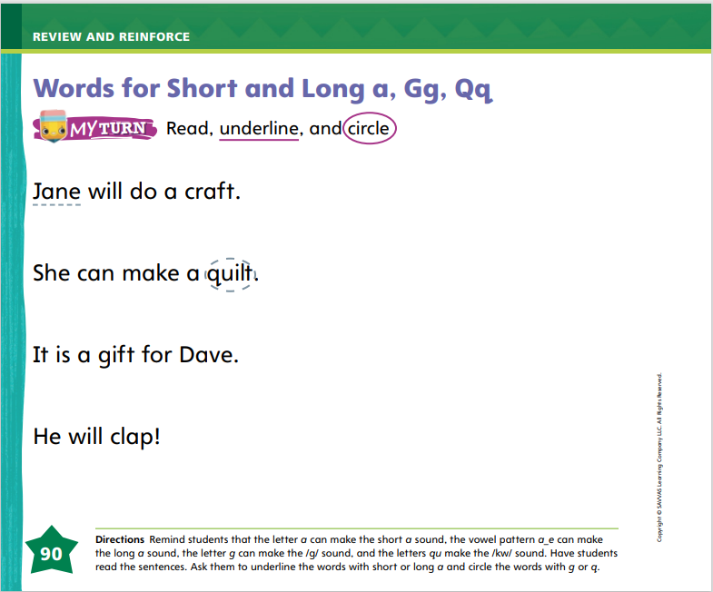
Page 90
Phonics
gap
Turn to page 90 in your Student Interactive and complete the activity.
quake
Notes:
Write the word gap on the board and read it with students. The word gap begins with the letter g. What sound does g spell? That’s right, /g/. Say the sound /g/ with me. What sound do you hear in the middle of gap? Students should say /a/. Yes, the letter a spells the sound /a/. Write quake on the board. The word quake begins with the letters qu. What sound does qu spell? That’s right, /kw/. Say the sound /kw/ with me. What sound do you hear in the middle of quake? Students should say /ā/. Yes, the vowel pattern a_e spells the sound /ā/.
Today we are reviewing the sounds /g/, /kw/, /a/, and /ā/. Have volunteers identify the letters or pattern that spells each of the sounds.
Have students turn to p. 90 in the Student Interactive. Have them use letter-sound relationships to decode the words on the page. Then have them underline the words with /a/ spelled a and /ā/ spelled a_e, and have them circle any words with /kw/ spelled qu and /g/ spelled g.

Slide 38
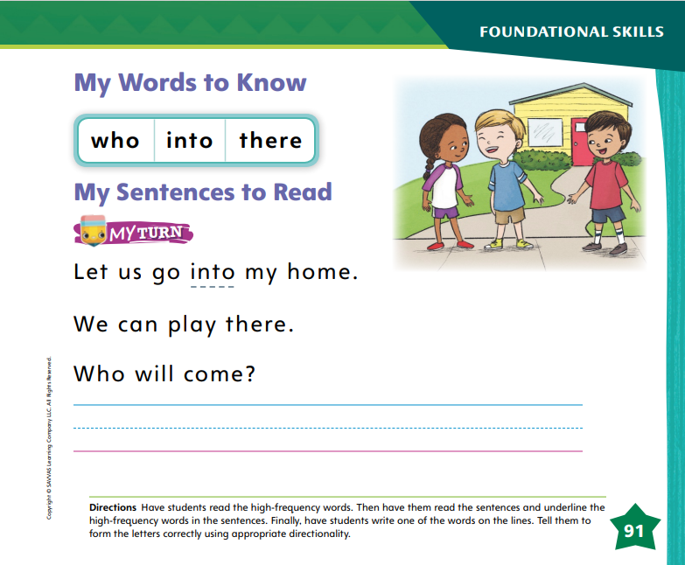
Page 91
High-Frequency Words
who
Turn to page 91 in your Student Interactive.
into
there
Notes:
Tell students that today they are going to continue working with high-frequency words. You will see these words over and over in texts. Have students read the words at the top of p. 91 in the Student Interactive with you: who, into, there.
Have students look at the words at the top of p. 91. Tell them to identify and point to each word when you say it. Say who. Pause to let students find and point to the word. Say there. Say into. Repeat the activity until students are familiar with each word.
Have students read the sentences on p. 91 with you. Ask them to identify the words who, there, and into in the sentences and underline the high-frequency words. Have them read the sentences with a partner. Then have students write one of the high-frequency words on the line.

Slide 39
Page 101
Discuss Rhyme and Rhythm
Notes:
Discuss rhyme with students. Provide some simple rhyming pairs such as can/man, hop/top, and bring/sing.
Words that rhyme have the same middle and ending sounds.
Listen carefully to the middle and ending sounds. Both must be the same in words that rhyme.
In words with only two sounds, such as by and tie, listen to the last sound to tell if they rhyme.
Discuss rhythm. Explain that songs, poems, and dances have rhythm because they usually have a beat.
Rhythm is a repeated pattern of sound. It means that you can tap along with the poem.
Model how you identify rhyme in a poem. Use the words on p. 103 of the Student Interactive. I know that when words rhyme, they have the same middle and ending sounds. I will read page 103 aloud and listen for words that rhyme. Read aloud the page. I hear the same middle and ending sounds in the words ground and mound: /ou/ /n/ /d/. These words rhyme. Rhyming words make poems fun to read.
Read aloud the poem on p. 98 in the Student Interactive again. Clap the rhythm as you read it. Have students say the poem with you and clap the rhythm. Then ask them to follow the Close Read note on p. 107 by underlining the words that rhyme.

Slide 40
Page 106, 107
Close Read – Discuss Rhyme and Rhythm
Turn to page 106 in your Student Interactive.
Notes:
Read aloud pp. 106–107 and have students listen for rhyming words. Then ask them to underline the rhyming words and clap the rhythm. DOK 2

Slide 41
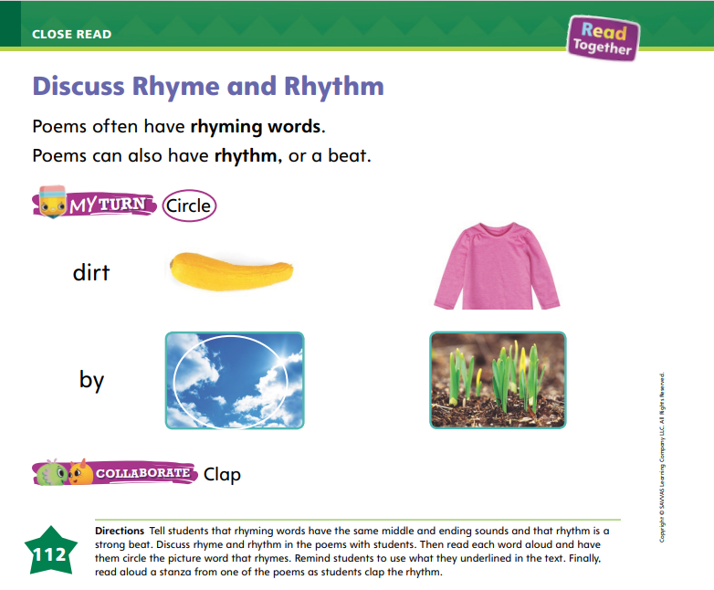
Page 112
Discuss Rhyme and Rhythm
Turn to page 112 in your Student Interactive and complete the activity.
Notes:
Have students use the strategies for identifying rhyme and rhythm.
Have students complete the rhyme and rhythm activities on p. 112 in the Student Interactive.

Slide 42
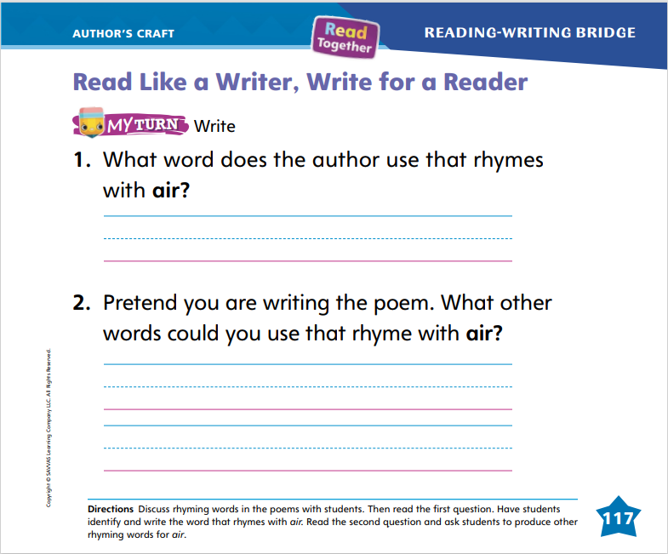
Page 117
Read Like a Writer, Write For a Reader
Turn to page 117 in your Student Interactive and complete the activity.
Notes:
Explain to students that writers of poetry use rhyme and rhythm to make poems more fun to read.
Rhyme is when words have the same middle and ending sounds but different beginning sounds.
Rhythm gives the poem its beat.
Have students look at p. 103 in the Student Interactive as you model. When I read this page, I can clap the rhythm. The word ground at the end of the second line rhymes with the word mound at the end of the next line. Ask students if they can think of any words that rhyme with mound and ground. (sound, found, pound, round, bound)
Have students work with a partner to complete p. 117 in the Student Interactive.

Slide 43
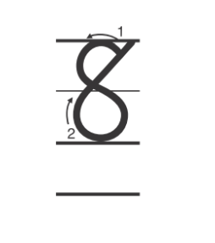

Handwriting
Notes:
Display the numerals 8 and 10. Ask students to name the numbers.
Model how to write the numeral 8, pointing out the two circles that form the numeral. Then have them trace the numeral on their hands. Repeat for the numeral 10.
Have students use Handwriting p. 273 in the Resource Download Center to practice writing numerals 8 and 10. Click path: Realize -> Table of Contents -> Resource Download Center -> Handwriting Practice -> U5W3L3 Handwriting Practice

Slide 44
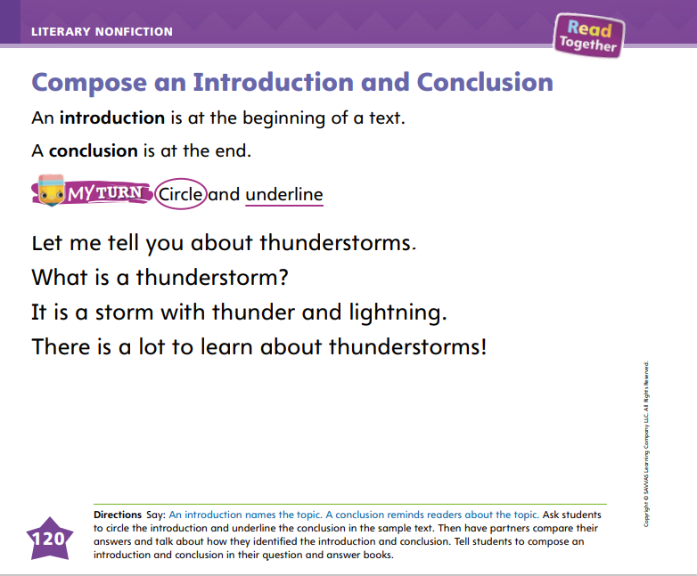
Page 120
Writing – Literary Nonfiction
Turn to page 120 in your Student Interactive.
Notes:
Tell students that the introduction and conclusion of a question and answer book tell readers about the topic.
Hold up a stack book that includes an introduction and conclusion. Work with students to identify each. Then say: Today I am going to show you how to write an introduction and conclusion. I want to write a book about the ocean. In my book, I want to tell readers all about the ocean. I will tell information about the way the ocean looks and the way it sounds. I will also tell other information about it. When I write my introduction, I should say my topic and what the book is mostly about. My topic is oceans, and my book is all about oceans. So I will write this introduction: The ocean is amazing! I am going to tell you all about oceans.
Write the sentences on the board. After my introduction, I will write many questions and answers about the ocean. Then I will write a conclusion. The conclusion should summarize what my book is about. My book tells many facts about the ocean, so I will write this conclusion: We learned a lot about the ocean!
Write the conclusion on the board. Tell students that when they write their own introductions, they should tell what the book will be about. When they write their conclusions, they should summarize what they wrote in their books.
Direct students to complete p. 120 in the Student Interactive.

Slide 45
Independent Writing
Continue writing your introduction and conclusion.
Share your introduction and conclusion with the class.
Notes:
As students transition into independent writing, have them work on composing their introductions and conclusions. Then they should continue writing their books.
Writing Support
Modeled - Walk through a stack text with students to show how introductions and conclusions are written.
Shared - Have students dictate their words as you transcribe their introductions and conclusions.
Guided - Ask students questions to help them form an introduction and conclusion.
Ask a few students to share their introductions and conclusions. The class should provide suggestions and recommendations.

Slide 46
Spelling
at
am
an
Notes:
Remind students that words with the VC pattern have a vowel followed by a consonant.
Have students write the following words as you isolate each phoneme: at—/a/ /t/; am—/a/ /m/; an—/a/ /n/.
Have students complete Spell Words p. 280 from the Resource Download Center. Click path: Table of Contents -> Resource Download Center -> Spelling -> U5W3L3

Slide 47
Language and Conventions-Pronouns
Sam runs.
Tom hops.
What does the sentence need to make it correct?
Notes:
Discuss with students that a complete sentence has a naming part (a noun or pronoun). Many sentences also have an action part (the verb). Remind students that a complete sentence begins with a capital letter and ends with a period, a question mark, or an exclamation point.
Display the following sentences: Sam runs. Tom hops The first sentence is a complete sentence. It has a capital letter at the beginning, a period at the end, a naming part, and an action part. As you model, circle the capital letter and period and underline the words Sam and runs. Read aloud the next sentence. Ask students to tell you what the sentence needs to make it correct.

Slide 48
Lesson 4

Slide 49
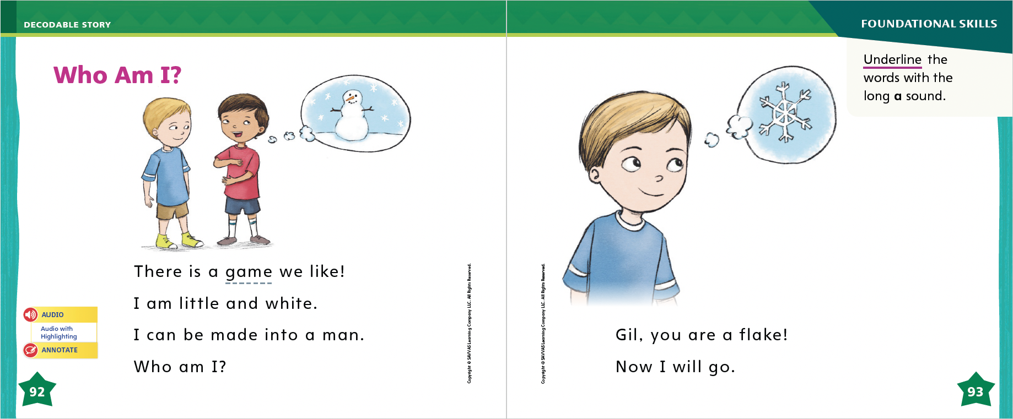
Page 92, 93
Decodable Story
who
there
into
Turn to page 92, 93 in your Student Interactive. We will Read “Who Am I?”
Notes:
Have students turn to p. 92 in the Student Interactive. We are going to read a story today about two boys who play a guessing game. Point to the title of the story. The title is Who Am I? I hear a word with the sound /a/. Have students find and point to the word Am in the title. In this story, we will read other words that have the sounds /a/, /ā/, /g/, and /kw/.
Remind students of this week’s high-frequency words: who, there, into. Tell them they will practice reading these words in the story Who Am I? Display the words. Have students read them with you. When you see these words in the story Who Am I?, you will know how to identify and read them.
Have students whisper read the story as you listen in. Then have them reread the story with a partner. Listen carefully as they use letter-sound relationships to decode words. Partners should reread the story. This time the other student begins.
After students have read the story, review the words with the sound /ā/ they read in the sentences on pp. 92–93. Have them underline the words with the sound /ā/ spelled a_e. Have students read the words to you.
Call students’ attention to the sentences on p. 92. Which words are high-frequency words that we learned this week? Point to them. Help students identify, or say, the words into and Who.

Slide 50
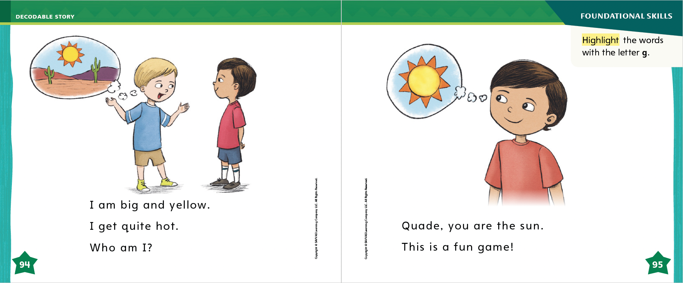
Page 94, 95
Decodable Story
Notes:
Have students turn to pp. 94–95. I see some words with the letter g. Who can tell me which words have the sound /g/ spelled g? Students should identify the words big, get, and game. Have students highlight the words with the letter g.
I also see a word with the letters Qu on page 95. Which word do you see that begins with Qu? Students should identify the name Quade.

Slide 51
Page 101
Visualize Details
Notes:
Tell students that good readers visualize the details in a text as they read.
Visualizing means forming a picture in your mind.
The picture can include what things look, sound, feel, smell, and even taste like.
Poets use describing words and words that are interesting to help readers visualize details.
Turn to p. 102 of the Student Interactive and read aloud the page. When I read the words “Water fills the air,” I picture heavy rainfall. The phrase “soaks into our hair” makes me picture children with water dripping from their hair onto their faces and running down onto their clothes. Being able to picture the words helps me understand the poem better.
Have students close their eyes as you read the lines on p. 103. After reading, have them open their eyes and tell what they pictured. Then ask students to follow the Close Read notes on pp. 105 and 109 by highlighting the words that help them visualize details in the poems.

Slide 52
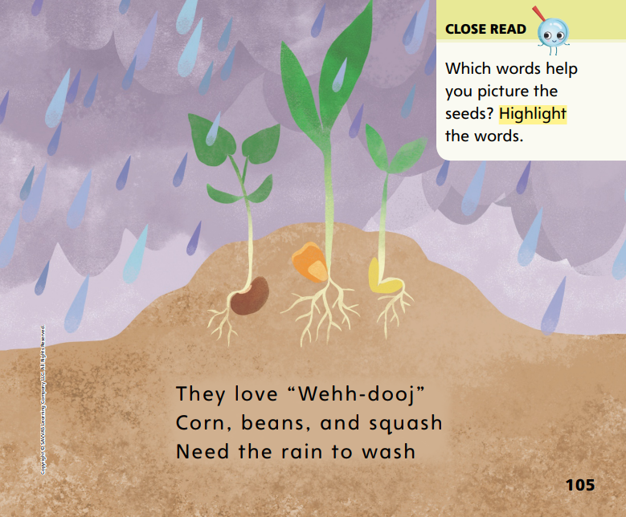
Page 105
Close Read – Visualize Details
Turn to page 105 in your Student Interactive.
Notes:
Tell students that authors use words to help readers picture what the author is writing about. Read the Close Read note on p. 105. Then work with students to find the words that help them picture the seeds. DOK 2

Slide 53
Page 108, 109
Close Read – Visualize Details
Turn to pages 108, 109 in your Student Interactive.
Notes:
Ask students to close their eyes and visualize as you read aloud pp. 108–109. Ask students to highlight words that help them picture the shoots. DOK 2

Slide 54
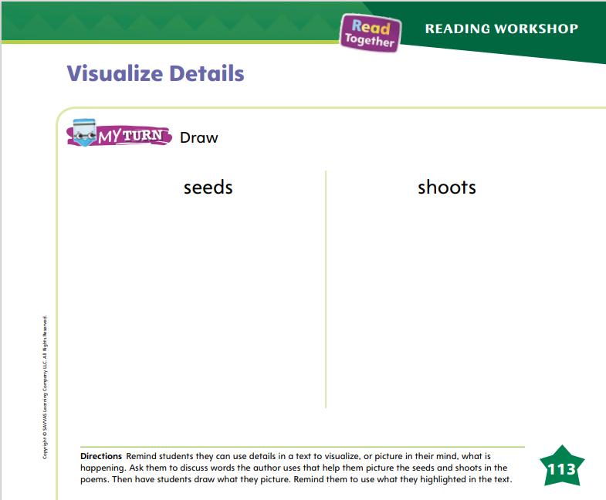
Page 113
Visualize Details
Turn to page 113 in your Student Interactive and complete the activity.
Notes:
Have students use the strategies for visualizing details.
Have students use what they have highlighted in the poems to draw pictures on p. 113 of the Student Interactive.

Slide 55
Writing – Literary Nonfiction
Look at the pictures in the text.
Guess what the question and answer could be based on the picture.
Think about the graphics you might add to your book.
Notes:
Graphics show more information about a topic. In question and answer books, graphics can be photographs or drawings. Authors use graphics to add details to a question or answer.
Read a text from the stack, pointing out the graphics. Look at the pictures, telling what you see. Think aloud as you guess what the question and answer could be based on the graphics. Then read the question and answer aloud. Recall how your guess using graphics matched up with the text.
Show the graphics in another stack text. Have students guess the question and answer based on the photos or drawings. Read the text aloud and make the connection between the graphics and text. Have students point out information they learned from the graphics that was not in the text. Say: Graphics can help readers understand the text better. A book’s graphics might be photographs that show what is being described or explained. Graphics can also be drawings that give more information to the reader. When you draw graphics in your question and answer book, make sure they match the text. Also try to include details in your picture so readers will learn more from it. You can add labels to your picture too.

Slide 56
Independent Writing
Continue writing your book and adding graphics.
Share one of your graphics with the class.
Notes:
After this lesson, students should transition into independent writing. Have students work on their graphics and then continue writing.
Writing Support
Modeled - Use a stack text to show how graphics add details to a book.
Shared Transcribe a student’s book based on the graphics.
Guided Prompt students to identify what details to include in their graphics.
Ask a few students to share their graphics and writing with the class. Conduct a discussion on how graphics add details to the book.

Slide 57
Spelling
flag
flag
flag
flag
slip
trap
Notes:
Have students recall the previous spelling rules for spelling words with the CCVC pattern.
Read the following words and have students spell them: flag, slip, trap.
Have pairs work together to think of other words with the CCVC pattern and spell the words.

Slide 58
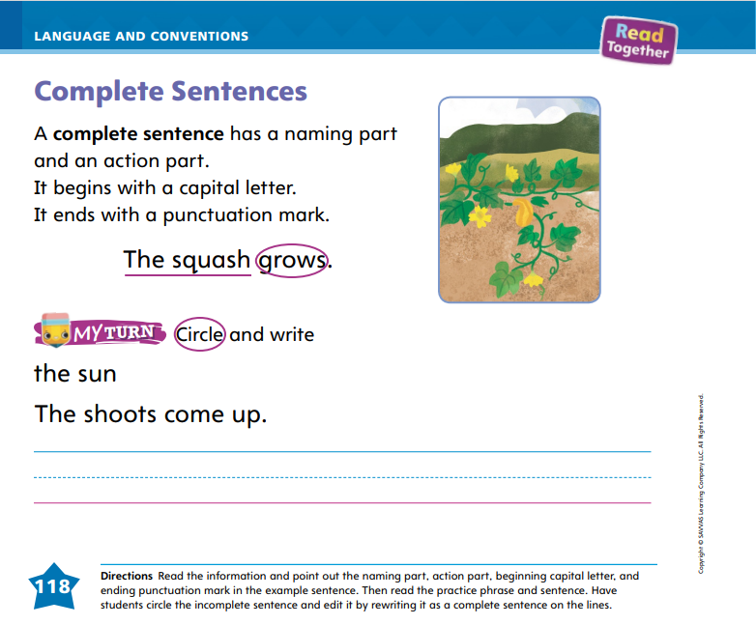
Page 118
Language and Conventions
Turn to page 118 in your Student Interactive and complete the activity.
Notes:
Ask students to work with a partner to complete p. 118 in the Student Interactive to write a complete sentence.

Slide 59
Lesson 5

Slide 60
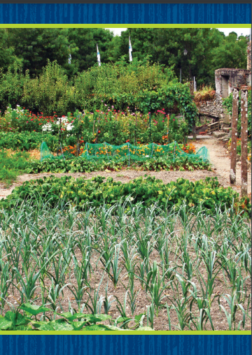
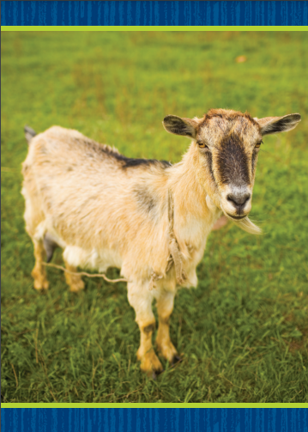
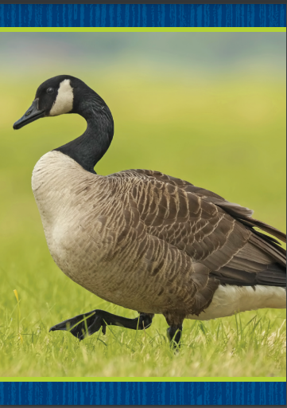
Phonological Awareness
Notes:
Tell students that today they will do more work with alliteration. Ask: Who can tell me what alliteration is? Students should say alliteration is when all or most words in a sentence begin with the same sound. Say the following aloud: Quinn quietly asked a question. What sound do most of the words begin with? Students should say /kw/. Have students come up with another word with the sound /kw/ to continue the alliteration.
Repeat the routine with the following: Gil got green grapes. Meggie made a mud pie.
Display the following Picture Cards: garden, goat, goose. Say each picture name aloud. What sound do you hear at the beginning of each word? Yes, /g/. Now think of two more words that begin with the sound /g/. Repeat the activity with the following Picture Cards: quarter, queen, quilt; ladybug, lake, leaf. Click path -> Table of Contents -> Unit 5 Week 3 Poetry-> Lesson 5

Slide 61
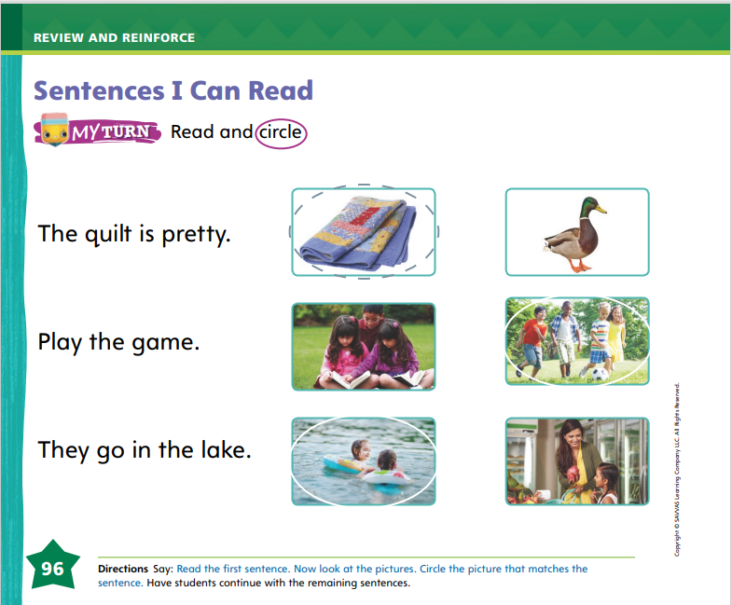
Page 96
Phonics
Turn to page 96 in your Student Interactive and complete the activity.
Notes:
Tell students that today they will read some sentences. The sentences we read will all include sounds and high-frequency words you have already learned.
Have students turn to p. 96 in the Student Interactive. Name the pictures on the page with students. Have a volunteer read the first sentence. Guide students to circle the picture that matches the sentence.

Slide 62
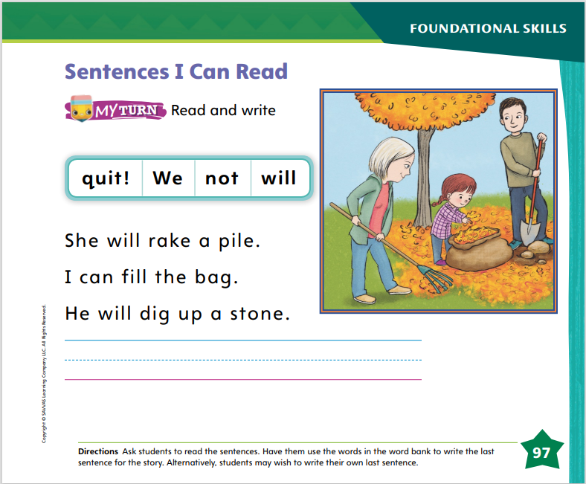
Page 97
Apply
Turn to page 97 in your Student Interactive and complete the activity.
Notes:
Have students look at p. 97 and read the sentences. Have them unscramble the words in the word bank to finish the story.

Slide 63
High-Frequency Words
who
into
there
Notes:
Remind students that high frequency words are words that appear over and over in texts.
Remind them they are learning many of the words this year, and the words will help them become better readers.
Say the word who and ask students what letters are used to spell the word.
Have students
say the letters as you write them on the board.
say and spell the word, touching their toes for each letter.
repeat with there and into.

Slide 64
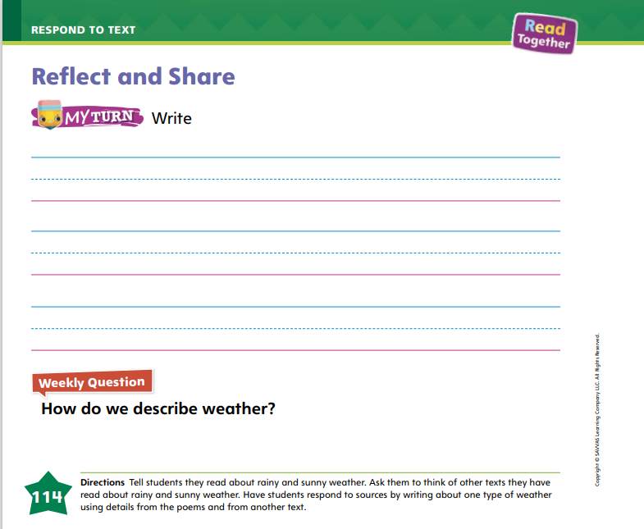
Page 114
Reflect and Share
Turn to page 114 in your Student Interactive and complete the activity.
Notes:
Tell students that we can write to compare two texts. When writing to compare two different texts, students should know that
a poem uses rhyme and rhythm, but other types of texts do not.
poems and informational texts may both tell about the same topic, such as the weather.
readers can look at what two texts say about the same topic to learn more about that topic.
Model what it means to write a comparison of two texts. Before I start writing, I think about texts I have read on the same topic. For example, I just read about rainy and sunny weather in two poems. The poems told how the rain and sun helped the seeds the children planted grow big and strong. I think about other books I have read about rain and sun. I can compare the information. I can see if I find out more about how plants need sun and rain. Then I can start writing.
Have students turn to p. 114 in the Student Interactive and write sentences about weather using what they learned from the poems and another text they have read.

Slide 65

Page 114
Apply
How do we describe weather?
Discuss in your group.
Notes:
Have students use evidence from the texts they have read this week to respond to the Weekly Question.
Tell them to discuss in small groups.

Slide 66
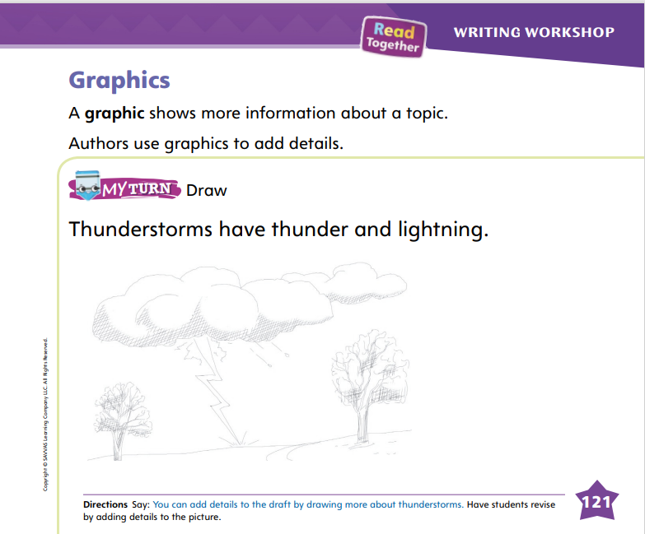
Page 121
Writing – Literary Nonfiction
Turn to page 121 in your Student Interactive.
Notes:
Tell students that graphics add details to a question and answer book. Authors choose images or drawings to match the information in their books.
Display a stack text that your class has not read. Begin reading the book without showing the pictures. Have students think about what you read, picturing it in their minds. After reading a few pages, return to the beginning and start again. This time, show the pictures. Then say: Authors include graphics in their books. The graphics give more information and help the reader picture what is happening in the text. What can you learn from the pictures that you didn’t know by reading the words? Engage students in a conversation about the information they learned from the graphics.
Then say: Today I will show you how to add graphics to your books. If you’ve already added graphics, you can add more details to them. I am writing a question and answer book about the ocean. In my book, I say that oceans have big waves. Some readers might not know what ocean waves look like. So I will draw a picture to go along with the words.
On the board or chart, write the sentence Oceans have big waves. Begin drawing a sketch of a wave in the ocean. The readers can look at this picture to learn more about waves. They can see what waves look like. What other details can I add to the drawing to tell my readers more about waves?
Allow students to suggest details, such as a person jumping in the waves, a surfer in the waves, or a boat on the waves. Discuss what readers can learn by looking at the details you added to the picture.
Direct students to complete p. 121 in the Student Interactive.
Have students show a picture from their book. The class should describe what they can learn from the picture.

Slide 67
Spelling
Bill had an apple for snack.
Danny keeps his room as neat as possible.
Who has a dog?
I am happy to be here.
My baby sister is at home.
We use a key to get into my house.
Notes:
(Note: Move the orange boxes to cover each bold spelling word before you read aloud the words and sentences.)
Read aloud the words and sentences. Have students spell each word with initial consonant blends and the two high-frequency words.
Bill had an apple for snack.
Danny keeps his room as neat as possible.
Who has a dog?
I am happy to be here.
My baby sister is at home.
We use a key to get into my house.
Reveal the spelling word and have students check their work.

Slide 68
Language and Conventions
Is the sentence written correctly?
the cat eats
Incorrect
Correct
Notes:
Display the following sentence and guide students to decide whether the sentence is correct as it is written.
the cat eats
Incorrect
Correct
Have students complete Language and Conventions, p. 286, from the Resource Download Center. Click path: Table of Contents -> Resource Download Center -> Language and Conventions -> U5 W3

Slide 69
Unit 5: Week 3
Grade K

